Slide 1
Personal Project
Rugby League News Website
Xaviar Hyatt

Slide 2
Why?
Large Media Providers (Sky & BBC) only release limited news articles: Signings, Sacking and Results
Small Newspapers local to teams write frequent articles covering a wider range of topics: Injuries, Rumours

Slide 3
User Stories
As a user I want access to news stories related to rugby league so I don’t have to search google for specific information
As a user i want to create an account so that I can receive news based on my preference
As a user I want to see team information & news
As a user I want to see player information
As a user I want to see upcoming fixtures and where they are televised
As a user i want to see the Super League table

Slide 4
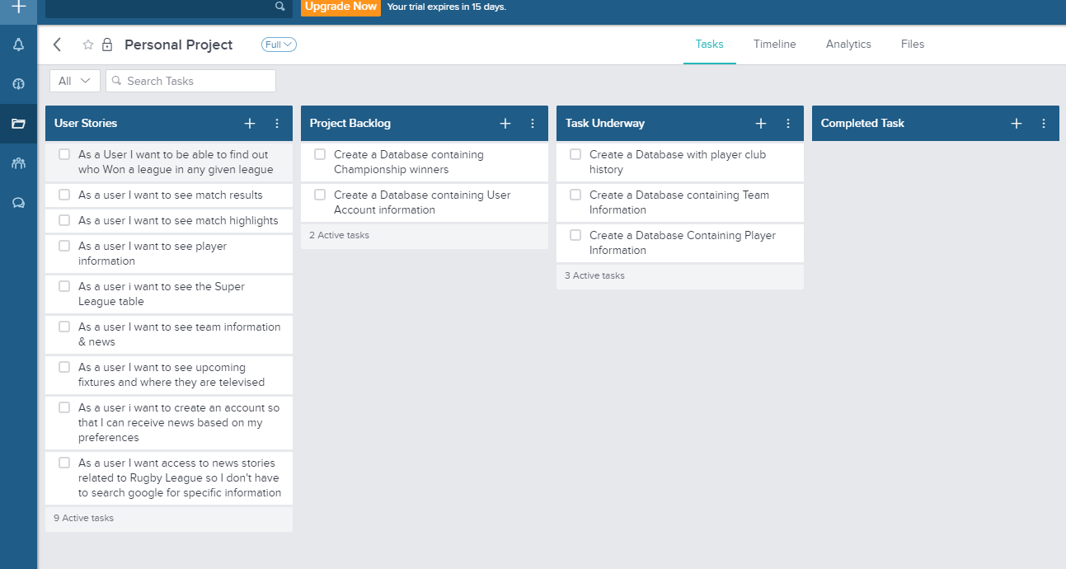
Trello

Slide 5
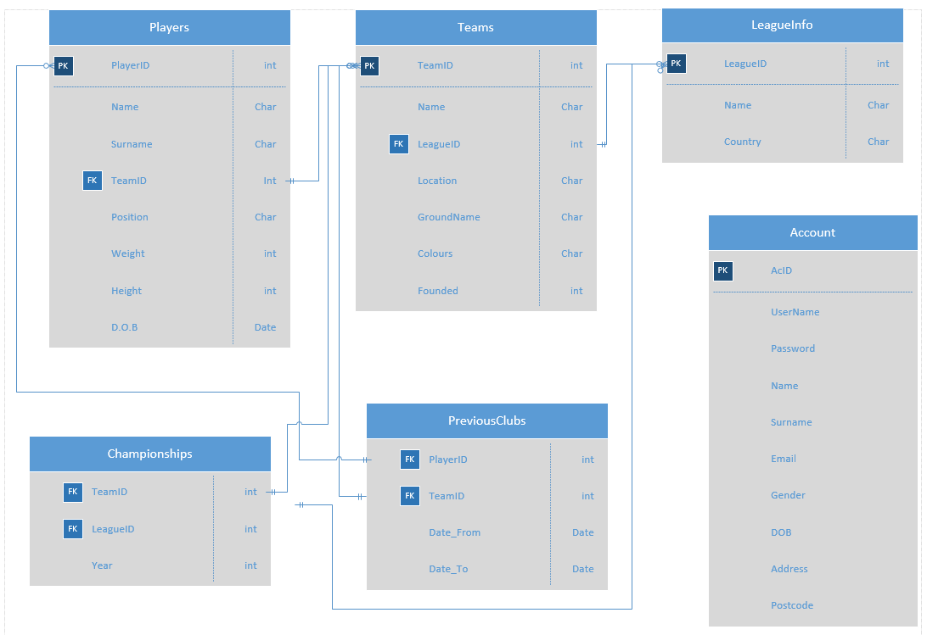
ERD

Slide 6
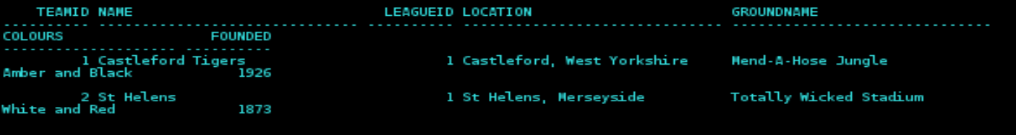
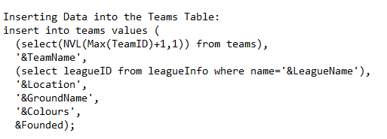
Team Database

Slide 7
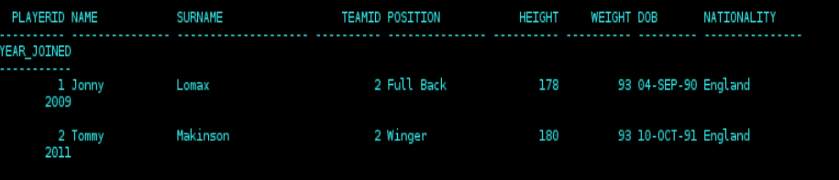
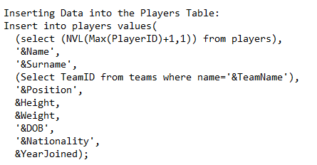
Player Database

Slide 8
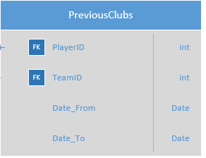
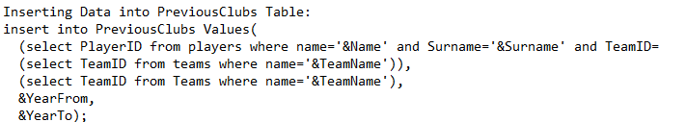
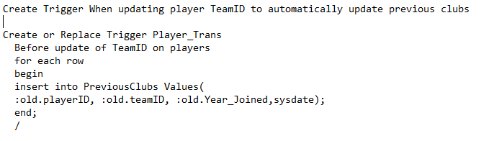
Previous Clubs Database

Slide 9
Questions?

